Slide 1
Fixing a Bug

Slide 2
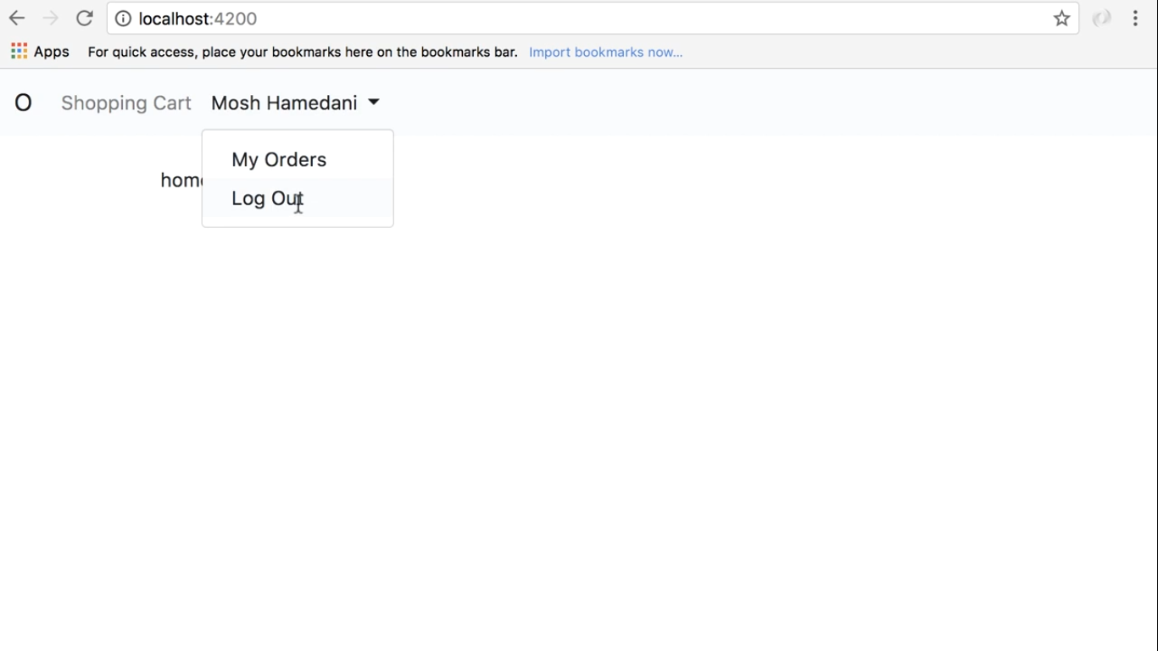
Cannot Logout

Slide 3
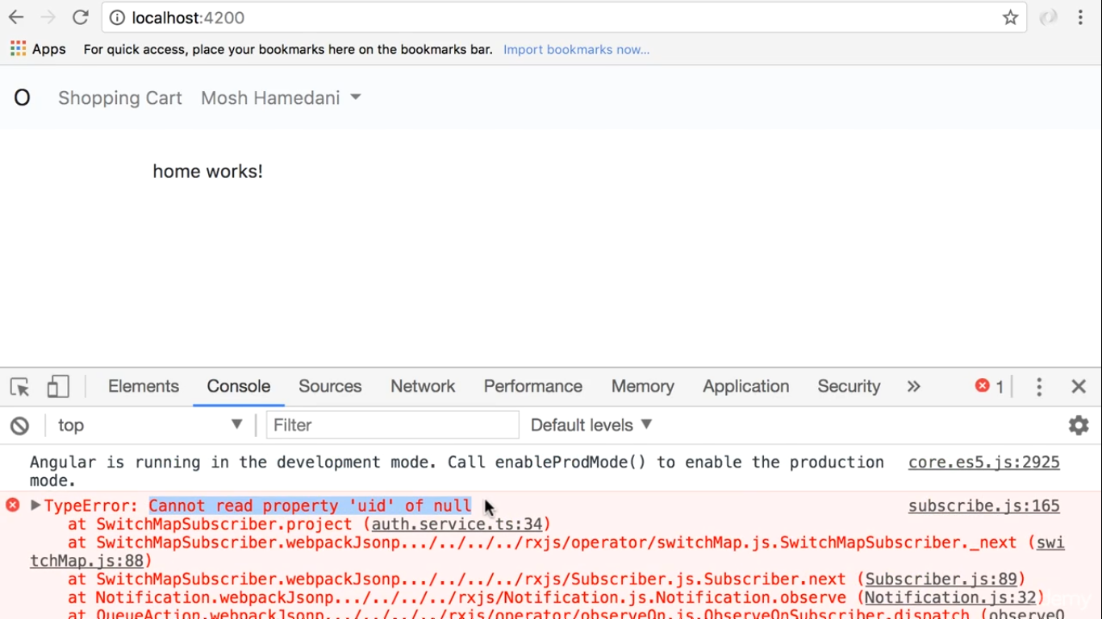

Slide 4
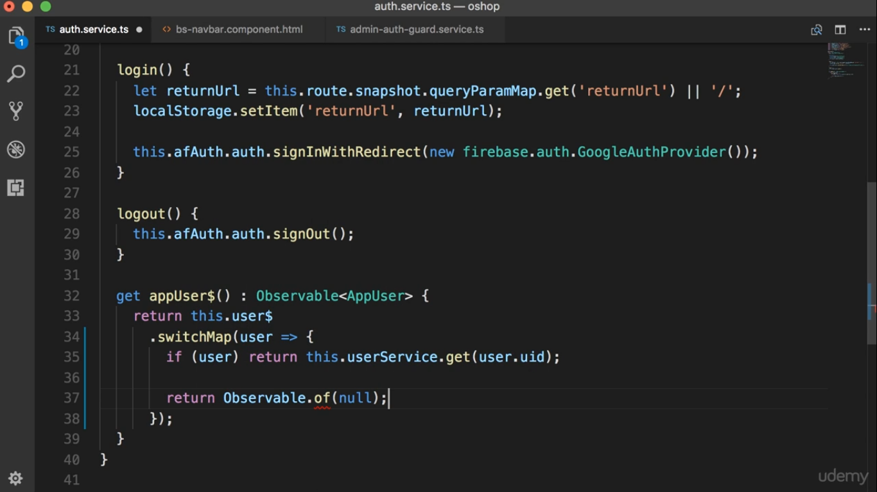

Slide 5
